Slide 1
DATA ANALYSIS AND ERROR CORRECTION

Slide 2
Data Analysis

Slide 3
Calculated Distance to Delay Ratio for the data collected for 45 nodes.
Used the average DDR for the data collected

Slide 4
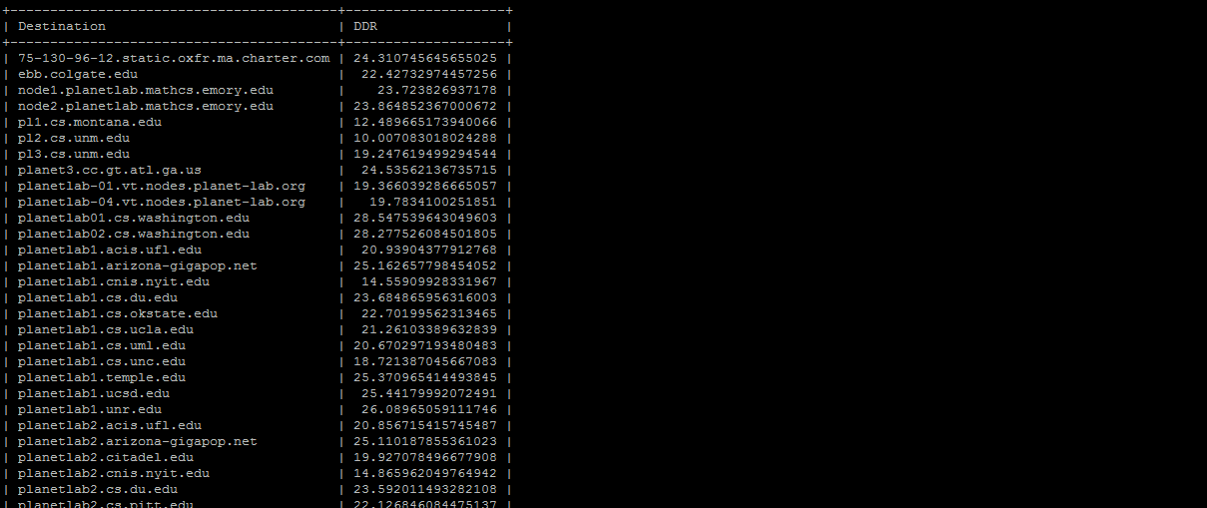
DDR

Slide 5
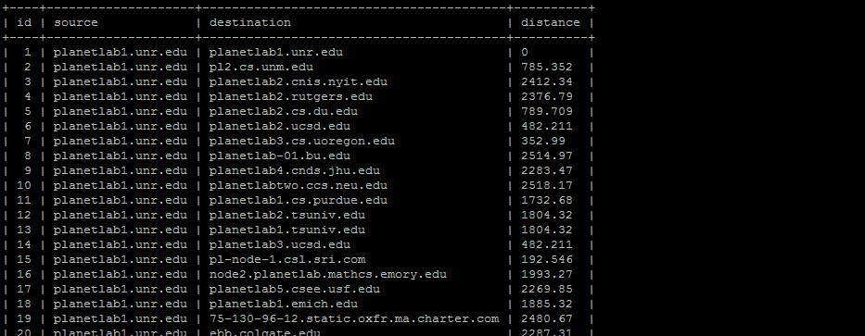
Distance of Nodes

Slide 6
Error Correction Techniques
In order to minimize errors due to delays, we have explored 3 error correction functions.
Weighted Least Mean Squares(LMSQ)
Probability Density Estimation(PROB)
Composite Statistical approach

Slide 7
Weighted Least Mean Squares(LMSQ)
Find the peak values from probability distribution of distance to delay for a particular rtt(S,H)
Error is calculated for each peak with:
Err(P,S,L)=(d(P)-d(S,L))² /prob(P)
d(p)- distance of P
prob(p) – probability of P

Slide 8
LMSQ (contd..)
Among these values, minimum value of error measure is computed with respect to Source
error(S,L)= min_{p}(err(P,S,L))
Error measure for all sources is the sum of total error measures from different sources
error(L)= sum_{s}(error(S,L))

Slide 9
Probability Density Estimation (PROB)
Joint probability distribution for every location based on delay information
Distance window of about 50miles around a given distance value
For a distance d(S,L), probability p(S,L) to an area under probability p(S,L) to be area under probability density curve within a distance window around d(S,L)

Slide 10
PROB (Contd..)
Joint probability to be the product of the individual probabilities.
p(L)= product_{s}(p(S,L))
Compute L with maximum value of p(L) and report it as location of H

Slide 11
Composite Statistical Approaches
Two other statistical approaches can be suggested: LMPR and PRLM, based on previous two approaches, LMSQ and PROB
In LMPR LMSQ is used to prune solution space and PROB is used to optimize the pruned space
In PRLM, it’s the reverse case

Slide 12
Experimental Results
LMSQ is the most widely used noise reduction technique but doesn’t work well
According to our findings, PROB gave better corrections to error than LMSQ
LMSQ as pruning method and PROB as optimization tool gives the best results.

